Slide 1
Introduction
Reference Models
Notes:
Video Module 1-01

Slide 2

Overview
Objectives
Learn and understand the design issues of networks and layered modelling
Learn and understand the OSI Reference Model
Learn and understand the TCP/IP Reference Model
Requirements
(Not covered in lectures) Read Sections 1.1 and 1.2
Read 1.3.1-.1.3.2
Read Sections 1.4.1-1.4.3
Read Sections 1.6.2-1.6.3

Slide 3
Introduction
Definition of a network
Key principles
Peer to peer layers communication using a protocol
Service between adjacent layers
Read Sections 1.1 and 1.2 (Not covered by lectures)
Read Sections 1.3.1 and 1.3.2

Slide 4
Introduction
A network is a set of independent devices which can communicate.
How independent?
Vendor independent
Hardware independent
OS independent
…..

Slide 5
Network Software : Issues to tackle
Error detection, error correction
Routing
Addressing, naming
Scalability
Flow control
Congestion control
Confidentiality, authentication

Slide 6
Networking Is a Complex Problem → Divide and Conquer..
Communication should be broken in layers such that:
Each layer has a well defined function
Adjacent layers have neat interfaces
Adjacent layers exchange minimal information
Each layer hides details from upper layers

Slide 7
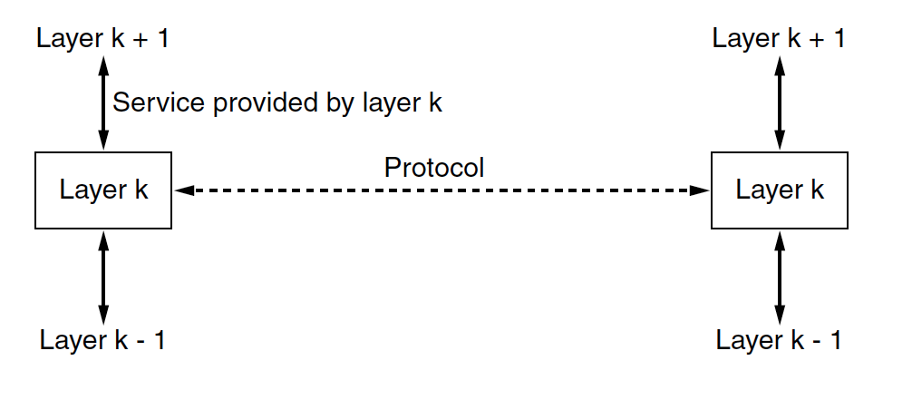
Key Principles of Layered Design!
To communicate, peers must
“speak” only to peers(they are snobs!)
use a common language/set of rules (Protocol)
Different levels of communications (Layers)
Above layer requests service from lower (adjacent) layer
Lower layer provides service to above layer
Requests/services are made/provided through interfaces.
Requests
Interface
Interface
Provides
Sender/Receiver
Sender/Receiver

Slide 8
Decomposing Communication in Layers
International effort led by ISO (International Standards Organization) → OSI Reference Model
Economical conflicting interests
Result: no viable stack implementation, but a nice formal model good for education and networking experts communication
Neat definition of:
Functions at each layer
Interfaces between adjacent layers
Early Internet community (mostly academia/Industry) → TCP/IP model
Today’s Internet uses the TCP/IP model : widely implemented

Slide 9
The OSI Reference Model
The OSI Reference Model
Read Introduction Section 1.4
Read Section 1.4.1
Notes:
Video Module 1-02

Slide 10
OSI Reference Model
User/Client
User/Server
Application
Protocol
Application
Interface
Interface
Presentation
Protocol
Presentation
Interface
Interface
Protocol
Session
Session
Interface
Interface
Protocol
Transport
Transport
Interface
Interface
Network
Network
Network
Network
Interface
Interface
Interface
Interface
Data Link
Data Link
Data Link
Data Link
Interface
Interface
Interface
Interface
Phys.
Phys
Phys.
Phys

Slide 11
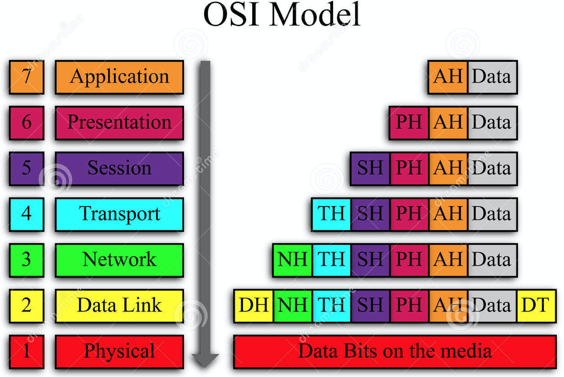

How Does Peer to Peer Communication Work?
Encapsulation (Sending)
Client/Server

Slide 12
How Does Peer to Peer Communication Work?
Encapsulation (Sending)
Client/Server

Slide 13
How Does Peer to Peer Communication Work?
Decapsulation (Receiving)
Client/Server

Slide 14
How Does Peer to Peer Communication Work?
Decapsulation (Receiving)
Client/Server

Slide 15
Two Kinds of Layers
End-to-end layers (or protocols):
Application
Presentation
Session
Transport
Point-to-point layers (or protocols):
Network
Link
Physical
Application
Presentation
Session
Transport
Network
Data Link
Physical

Slide 16
Implications
End-to-end layers: implemented (active) only on the end points of a conversation.
Point-to-point: implemented (active) throughout ALL the path, on endpoint nodes and intermediary nodes
Application
Presentation
Session
Transport
Network
Data Link
Physical

Slide 17
End to End Layers
End to end layers
(Re)-Read Section 1.4.1
Application
Presentation
Session
Transport
Notes:
Video Module 1-03

Slide 18
Application Layer
End to end layer
It provides specialized services such as:
DNS
File transfer
Email
http
ssh
Application
Presentation
Session
Transport
Notes:
The application layer can use communication for different things. DNS provides the IP address without direct use.

Slide 19
Presentation Layer
Application
Presentation
Session
Transport
End to end
The two communicating entities may be different (different vendors, different OS, different CPUs)
System M1
System M2
Application
Application
Presentation
M1 Representation
Presentation
M2 Representation
Translation
Translation
COMMON Representation
COMMON Representation
Communication System
Notes:
Data is not represented the same way. Communication system uses network bit order. Whatever is on the wire is in network bit order.
M1 is showing something common as does M2, then goes to what the machine wants.

Slide 20
Presentation Layer (Cont’d): Examples of Common Rep’s
Application
Presentation
Session
Transport
Integers Representation
Little endian (stores first the least significant byte at the address)
Big endian (Network Byte Order) (stores first the most significant byte at the address)
Imagine a sender that uses little endian. It wants to send a word 0x1234 to a machine that uses big endian. The receiving machine will read 0x3412
Receiving a short number: use ntohs() before storing
Sending a short number: use htons() before sending
Receiving a long number: use ntohl() before storing
Sending a long number: use htonl() before sending
Real numbers:
Floating point numbers: IEEE 754
Notes:
Receiving would used network-to-host. (s) = (receiving)short. (l) = (receiving)long. Functions are on the host machine. Machines in little endian HAVE to switch. Standard for Real.

Slide 21
Session Layer
End to end layer
Allows establishing communication sessions:
File transfers under bad network conditions.
Optimize the use of a communication system

Slide 22
Transport Layer
Application
Presentation
Session
Transport
End to end layer
Hides/adapts defects and limitations of the network sys:
error control, addressing, congestion control, flow control….
Protocol examples: TCP, UDP
Upper Layers
Upper Layers
Too big message
Transport Layer
Transport Layer
5
3
4
4
3
5
2
3
1
1
Network System
(may loose, duplicate, reorder)
Notes:
Transport layer’s job is to push back the big message to the boss in the right order. It will also use flow control for slow machines. It will pace the sender. The network itself can be congested.

Slide 23
Point to Point Layers
Point to point layers
(Re)-Read Section 1.4.1
Network
Data Link
Physical
Notes:
Video Module 1-04

Slide 24
Network Layer
Point to point layer
Addressing
Routing
Congestion control (Maybe)
Administration

Slide 25
Data Link Layer
Point to point layer, has two sublayers:
Logical Link Sublayer
Framing
Error control
Flow control
addressing
Medium Access Control Sublayer

Slide 26
Physical Layer
Transmission of raw bits
Deals with:
Electrical specs
Mechanical specs

Slide 27
Conclusion
The OSI reference model is a nice conceptual model
There is no large scale implementation of an OSI protocol stack
The OSI model is largely used by networking people (conceptually).
It is good for teaching networking
Notes:
Request for Comments(RFC)

Slide 28
TCP/IP Model
TCP/IP Model versus OSI Reference Model
TCP/IP Model
Read Section 1.4.2
Notes:
Video Module 1-05

Slide 29
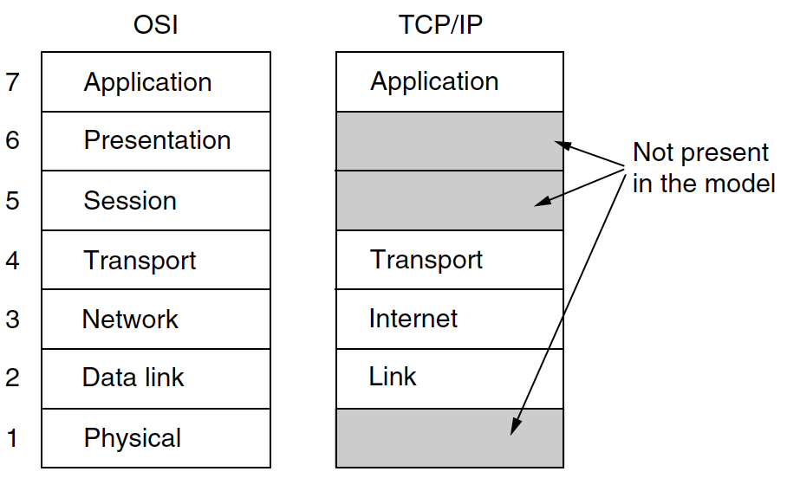
Difference OSI and TCP/IP Models

Slide 30
Difference OSI and TCP/IP Models

Slide 31
TCP/IP Model
“Running code and some consensus”
RFCs (Request For Comments)
TCP/IP Model
Application Layer
SMTP
FTP
HTTP
DNS
Telnet
..
Transport Layer
TCP
UDP
Network Layer
IP (and some “helpers”)
Link Layer
DSL
802.3
802.11
Physical Layer
DSL
802.3
802.11

Slide 32
TCP/IP Stack
Application layer:
SMTP: Simple Mail Transfer Protocol (Port 25)
FTP : File Transfer Protocol (Port 20/21)
Telnet : Terminal… (Port 23)
HTTP: HyperText Transfer Protocol (Port 80)
DNS : Domain Name System (port 53)
Transport layer:
UDP: User Datagram Protocol (Protocol # 17)
TCP: Transmission Control P. (Protocol # 6)
Network layer:
IPv4 or IPv6 : Internet Protocol

Slide 33
Reference Model for This Course
Application
Transport
Network
Link
Physical
Notes:
WHOOAAAAAA !!!!!!!!

Slide 34
Network Devices and Layers
Repeater (hub)
Bridges
(Data Link) Switches (or L2-switches)
Routers (or L3-switches)
Internet hosts:
Clients
Servers
Notes:
Video Module 1-06
Making connections between physical links
All 7 layers need to be active

Slide 35
Repeater (Hub)
Used to “repeat” a signal:
It amplifies it
It “Straightens” it
Physical

Slide 36
Bridges
Old devices
“Extends” a local area network
Filters traffic (from subnet to another)
Data Link
Physical

Slide 37
(Data Link)/ L2 Switches
Used on local area networks
Better than broadcast medium:
Increases the number of simultaneous communications
Data Link
Physical

Slide 38
Routers (or L3-Switches)
Connect different networks
Forward packets from a network to another
Network
Data Link
Physical
Notes:
Routers connect networks, it will see something on one network(I saw this on that network, where should it go?)

Slide 39
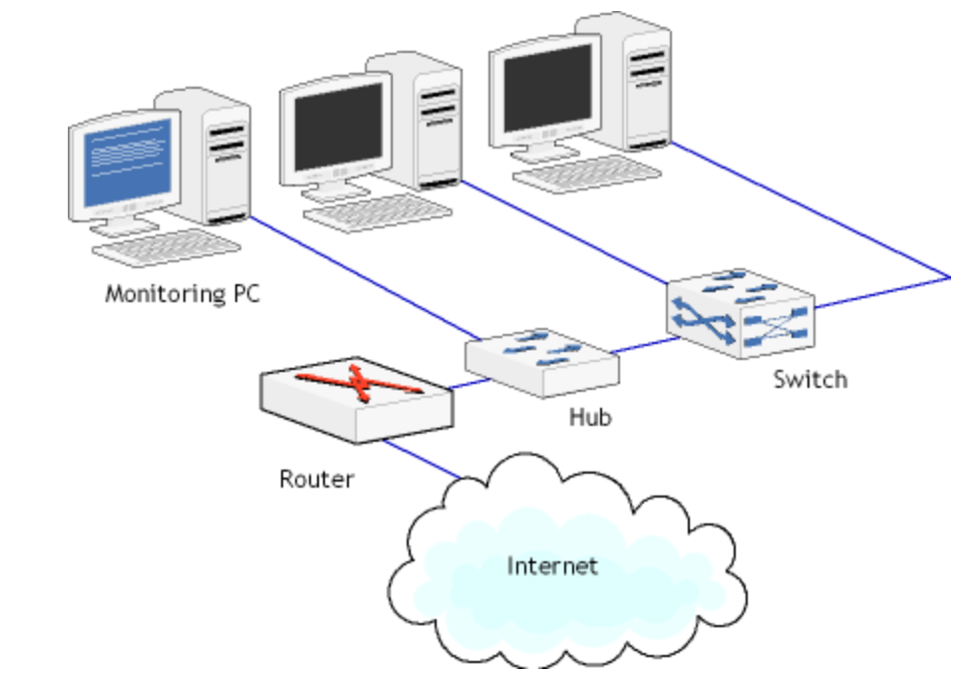
Hub, L2-switches, and Routers

Slide 40
Hosts (Clients or Servers)
Used on end points of conversations
Application
Presentation
Session
Transport
Network
Data Link
Physical
Notes:
Need all layers.

Slide 41
Wrap Up
Learn and understand the design issues of networks and layered modelling
Learn and understand the OSI Reference Model
Learn and understand the TCP/IP Reference Model
Notes:
Video Module 1-07

Slide 42
Self Study Quiz
What is a protocol?
Why is layering good? What is the role of a layer (in general)?
What are the layers in the OSI reference model?
Which layers in the OSI reference model are end-to-end?
Which layers in the OSI reference model are point-to-point?
How do end-to-end layers from point-to-point layers?
Can an end-to-end layer be implemented on an intermediary node such as a switch or a router?
On Slide 3 (Set 1), we listed some issues (services/functions): error detection, error correction, routing, addressing, naming, flow control, congestion control. For each layer in the OSI reference model, cite the issues/functions/services handled by that layer. (some issues/functions/services may be handled by different layers)
For each layer of the OSI reference model, cite one protocol used at that layer.
To which layer does the little/big endian belong in the OSI refrence model?
Which layers handle multiple similar issues/functions/services? Why do such different layers handle similar functions? Isn’t this redundant?
Cite four protocols used at the Application layer in the TCP/IP stack.
Cite two protocols used at the transport layer in the TCP/IP stack.
Cite one protocol used the network layer in the TCP/IP stack.
Does TCP provide service to IP or the reverse?

Slide 43
Self Study Questions
What is the difference between a point-to-point layer and an end-to-end layer?
In the OSI reference model, which layers are point-to-point?
In the OSI reference model, which layers are end-to-end?
In the TCP/IP reference model, which layers are end-to-end?
Cite two transport layer protocols used on a TCP/IP network stack.
What are the services that TCP offers?
What are the services that UDP offers?
What are the services that IP offers?
What are the key differences between TCP and UDP?
Which of TCP and UDP is best?
What is the IP of the device on which you are doing this SS quiz?
What is the use of an IP address?
How many bits does an IPv4 address contain?
How many bits does an IPv4 address contain?
What is the use of a port number? How many bits does it have?
How do an IP address and a port number differ?

